Slide 1
Virtual Velocity Banking Application
Authors:
fahad hameed & Dharmesh moradiya

Slide 2
Problem: where did all my money go?
Short Answer: You spent it.
Long Answer: Wasteful spending can be reduced by having a budget…but most people don’t have time to meticulously plan out their budgets.
Solution: This application doesn’t take all the thinking out of the equation, but it does provide a visual representation of exactly where your money is going.

Slide 3
VVBank
Theme: A Banking Application that allows you to track your expenses, and get a good idea of how much money you have spent in the last few months.
Side Thought: We could redo this application to be more of a ‘Expense Tracker’ instead of going with a bank theme. Might be more relevant to the user in the end…

Slide 4
How does it work?
You enter in your transaction data. Anytime you make a transaction that removes money from your account, it will be categorized in a common group.
You can view your transaction data in a tabular format, or in a pie chart.
You can filter by date, and see expenses for the last month, two months, or three months.
The more data you enter, the more accurate it becomes.

Slide 5
The Plan
4 Project Phases
Planning – 7 Days (Nov 11 ~ Nov 18)
Sketches, Scope, Brainstorming, Feature Definition
Design – 12 Days (Nov 18 ~ Nov 25)
Implementation, Iteration, Functionality, Exception Validation
Polish – 9 Days (Nov 25 ~ Dec 4)
Review, CSS, W3C Validation, Cleanup, Prepare Presentation
Presentation – 2 Days (Dec 4 ~ Dec 6)
Presentation Dry Run / Presentation Day

Slide 6
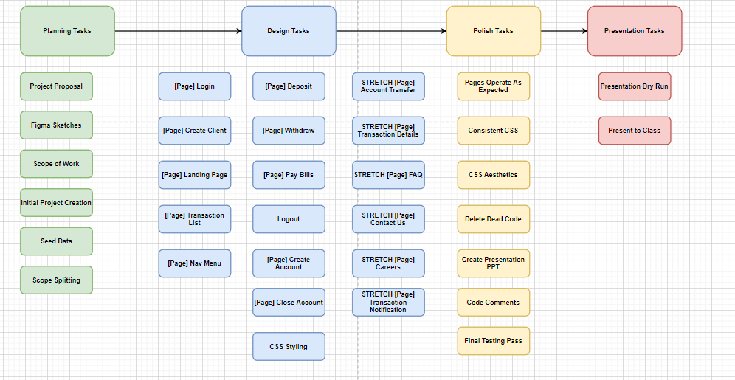
The tasks

Slide 7
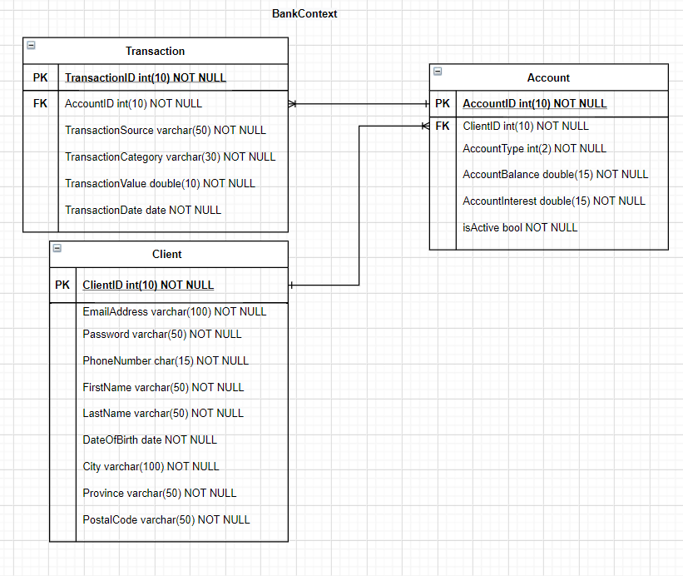
The database

Slide 8
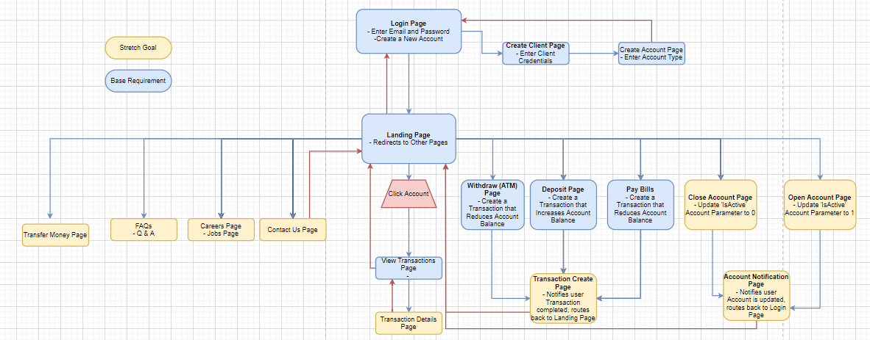
The site

Slide 9
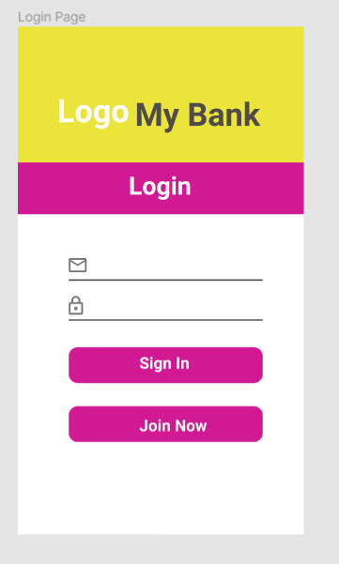
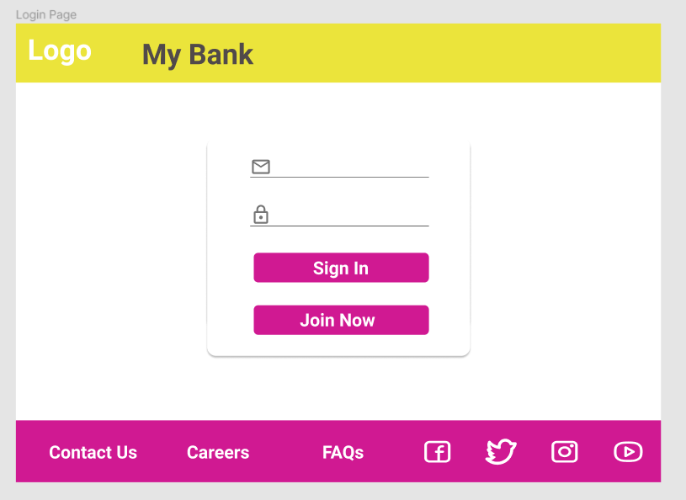
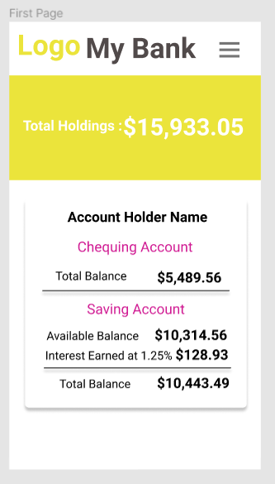
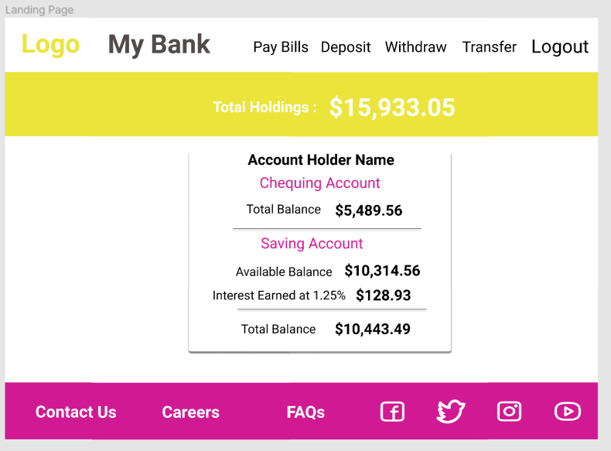
The design

Slide 10
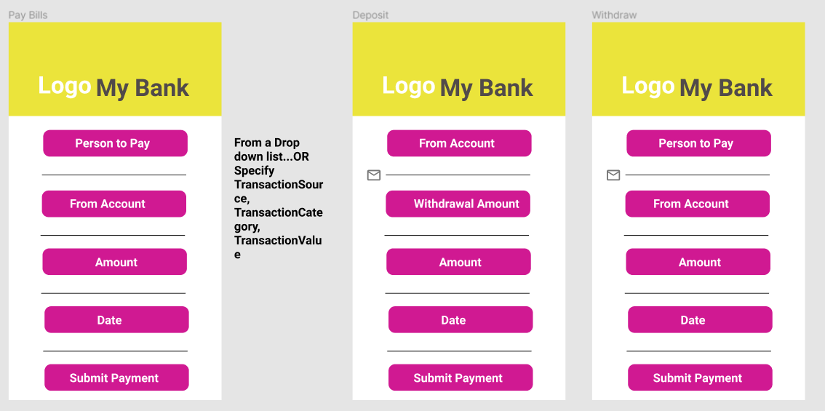
The design

Slide 11
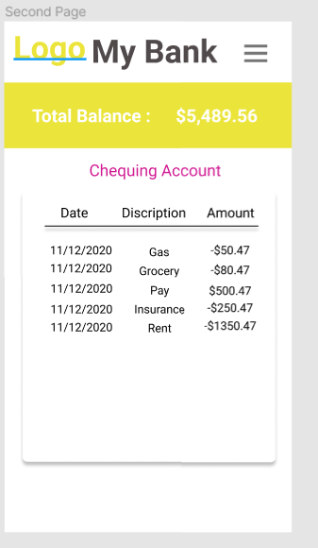
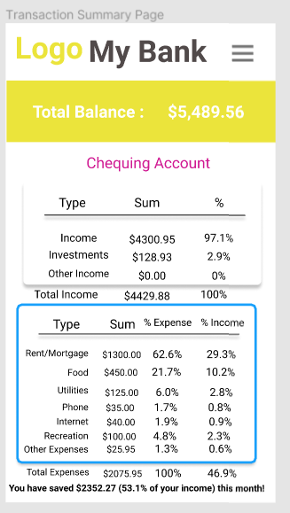
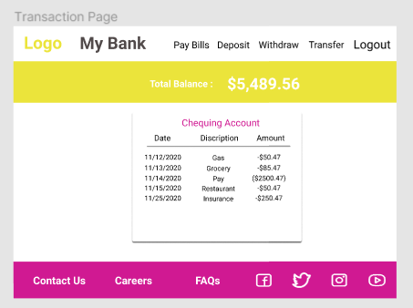
The design

